Slide 1

Daily Batch Run Time Automation
Belk Idea Hunt 2015

Slide 2

People Contributed
Associate ID | Associate Name | Project
393423 | Pratik Majumder | Belk SMART Batch Monitoring
393028 | Hemlata Mandawat | Belk SMART_Legacy Merch AVM
393424 | Saptarshi Ghosh | Belk SMART Batch Monitoring

Slide 3

Issues and Solution Suggested
Daily Batch Report is sent to the clients regularly after completion of nightly batch.
There are two major parts in this report : 1. Total Run Time Calculation for each critical Box (Excluding Overlapping Time) 2. Longest Running Job for a Box.
There are such 17 Boxes and approx. 250 Jobs related to this calculation.
Issues
Solutions
Solutions
Time reduction: Takes less amount of time (approx. 2 hrs. less)
Automatic Process: Chances of manual errors are less.
Time Consuming: The whole process is currently done manually which takes 2.5 hours for one person.
Manual Error: There might be chances of manual flaws.

Slide 4
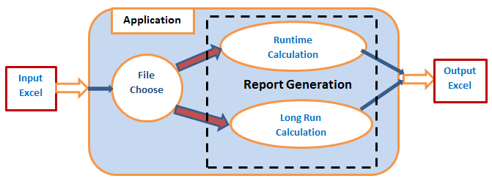

Detail Solution Approach & Timeline
Below is a generalized flow , which describes its functions as a Stand Alone Java application
Solution Approach
A simple Java Stand Alone application, which can run in java environment.
Copy Input Data manually (Start Time, End Time, Job Name etc.) from Autosys into an Excel (Input Excel).
Application will take the excel (Input Excel) as Input Feed, will Execute the logic and Output will be generated in another new excel ( Output Excel) automatically.
Timeline
2 PD for Requirement Gathering, 6 PD for Development, 2 PD for Testing.
Tentative Implementation Date: April, 2015

Slide 5
Benefit and Dollar Value Computation
Benefits:
Elimination of 2 hrs. of daily effort from CAM Team. Total = 60 hrs. monthly savings.
Will be able to send Daily Batch Report every day within an hour of Nightly Batch Completion.
Dollar Value Computation:
Cost of Innovation= 2 PD (Requirement Gathering) + 6 PD (Development)+ 2 PD (Testing) = 10 PD
Manual Report preparation-
Time Spent =2 Hours per day = 7.5 PD per Month = 90 PD per YOY Basis.
Benefits of Report Automation-
Person days = (90 PD – 10 PD) = 80 PD per YOY Basis.
Dollar Savings-
Soft Dollar Savings= 80 PD * ($30 / Hr *8 Hr)= $300 per YOY Basis.

Slide 6


